Slide 1
MKTG 571:
Customer Retention & Add-On Selling
The Art and Science of CRM

Slide 2
Today’s Agenda
To illustrate how firms can successfully manage customer relationships for retention, add-on selling, and long-term profitability
To discuss the difference between the art and science of relationship marketing

Slide 3
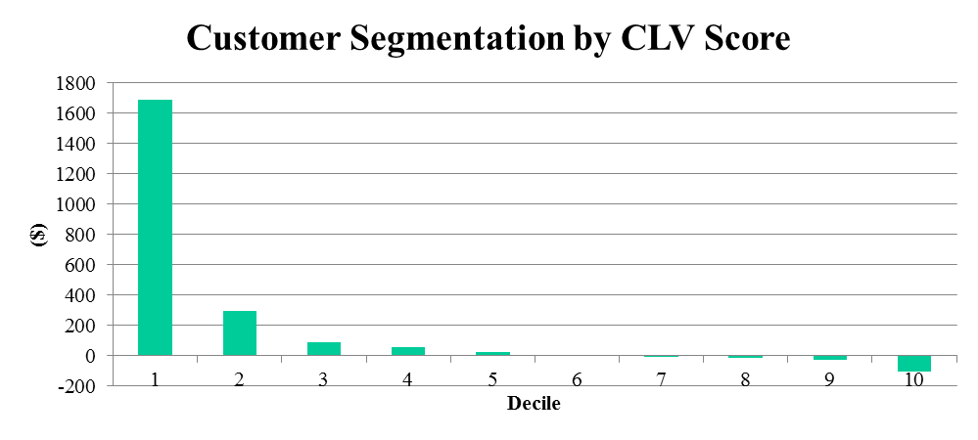
Customer Profitability
The need for customer differentiation and relationship management
1690
297
92
56
22
1
(6)
(16)
(19)
(104)
High CLV
Med CLV
Low CLV

Slide 4
Retention Spending
The link between retention spending and long-term customer profitability is positive (but diminishing)
Positive links include:
  How Often You Purchase (Frequency)
  How Long You are a Customer (Lifetime Duration)
  How Much You Spend (Monetary Value)

Slide 5
Customer Retention
The difficulty in establishing the exact linkage between retention spending and profitability is: Time
Past Spending
Past Behavior
Past Profitability
Σ
Retention Spending
Customer Behavior
Customer Profitability
Future Retention Spending
…
CLV

Slide 6
Customer Retention
Drivers of Customer Profitability?
  Past Spending
  Retention Spending (When and How Much)
  Customer-initiated Communication
  Cross-buying/Focused Buying
  Average Inter-purchase Time
  Product Return Behavior
  Loyalty Program Membership
  Share of Wallet (SOW)
  …
How do we manage the drivers of customer profitability?
Notes:
As an example for the firm on Slide 3. An increase in the following variable from the mean across all customers led to an increase in CLV by:
Crossbuy – 20%
Multichannel Shopping – 18%
Depth of Buying (Focused Buying) – 14%
Relationship Duration – 12%
Frequency – 7%
Product Returns – (-2%)

Slide 7
An Example
Repurchase (or not)
In this example we want to know the drivers of repurchase behavior.
Data is from Chapter 4 in Statistics in CRM book
(Download data and SAS code from Canvas)

Slide 8
An Example (cont.)
Dependent Variable
Purchase | 1 when the customer purchased in the given quarter and 0 if no purchase occurred in that quarter
Independent Variables
Lag_Purchase | 1 if the customer purchased in the previous quarter and 0 if no purchase occurred in the previous quarter
Avg_Order_Quantity | The average dollar value of the purchases in all previous quarters
Ret_Expense | Dollars spent on marketing efforts to try and retain that customer in the given quarter
Ret_Expense_SQ | Square of dollars spent on marketing efforts to try and retain that customer in the given quarter
Gender | 1 if the customer is male, 0 if the customer is female
Married | 1 if the customer is married, 0 if the customer is not married
Income | 1 if income < $30,000 2 if $30,001< income < $45,000 3 if $45,001 < income < $60,000 4 if $60,001 < income < $75,000 5 if $75,001 < income < $90,000 6 if income > $90,001
First_Purchase | The value of the first purchase made by the customer in quarter 1
Loyalty | 1 if the customer is a member of the loyalty program, 0 if not

Slide 9
Run Analysis in SAS

Slide 10
An Example (cont.)
How accurate are we?
88% hit rate
 |  |  | Actual Repurchase
 |  |  | 0 | 1 | Total
Predicted Repurchase | 0 |  | 2,494 | 330 | 2,824
 | 1 |  | 328 | 2,348 | 2,676
 | Total |  | 2,822 | 2,678 | 5,500

Slide 11
Optimal Contact Strategies
Problem Setup:
  We want to understand the optimal marketing communication strategy across multiple marketing communication channels
  We need to predict when someone is going to buy, what they are going to buy, and the best way to contact (how) that person

Slide 12
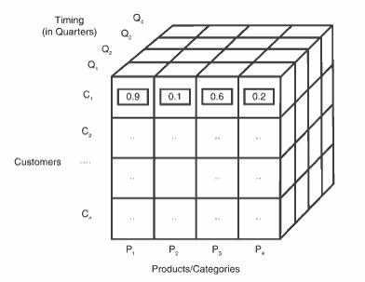
Optimal Contact Strategies
Contact the right customer at the right time with the right message:
The Customer
Profitability Cube

Slide 13
Optimal Contact Strategies
Face-to-Face Meetings Current: Every 4 months Optimal: Every 1 month Direct Mail/Telesales Current: Every 21 days Optimal: Every 13 days | Face-to-Face Meetings Current: Every 6 months Optimal: Every 4 months Direct Mail/Telesales Current: Every 13 days Optimal: Every 4 days
Face-to-Face Meetings Current: Every 6 months Optimal: Every 14 months Direct Mail/Telesales Current: Every 27 days Optimal: Every 26 days | Face-to-Face Meetings Current: Every 3 months Optimal: Every 4 months Direct Mail/Telesales Current: Every 10 days Optimal: Every 19 days
Results:
We see that our optimal contact strategy is a function of the value of the customer and the expected duration of the customer. The message and timing is a function of the customer probability cube on the previous slide.
High
CLV
Low
Low
High
Duration of Relationship

Slide 14
Preventing Churn
What is the impact of attrition?
Who is likely to defect? When?
When do you intervene?
How do we intervene?

Slide 15
Putting the R Back Into CRM
Customer (Relationship/Profitability) Management
The art vs. the science of relationships
  How much does data and models help?
  How much does ‘knowing’ the customer matter?
Observed behavior vs. Actual attitude

Slide 16
Putting the R Back Into CRM
Three Principles:
  Get to Know Customers as People
  Think Beyond Loyalty
  Take Responsibility for Relationships that are Two-Way

Slide 17
Customers are People
CRM systems are designed to collect observed behaviors and demographics
  Is there a systematic way to collect this data?
  Should we try to collect this data?

Slide 18
Thinking Beyond Loyalty
The CRM objective: Outcomes vs. Inputs
Brand Relationships
  How do we identify them?
  How do strategies differ when managing customers?

Slide 19
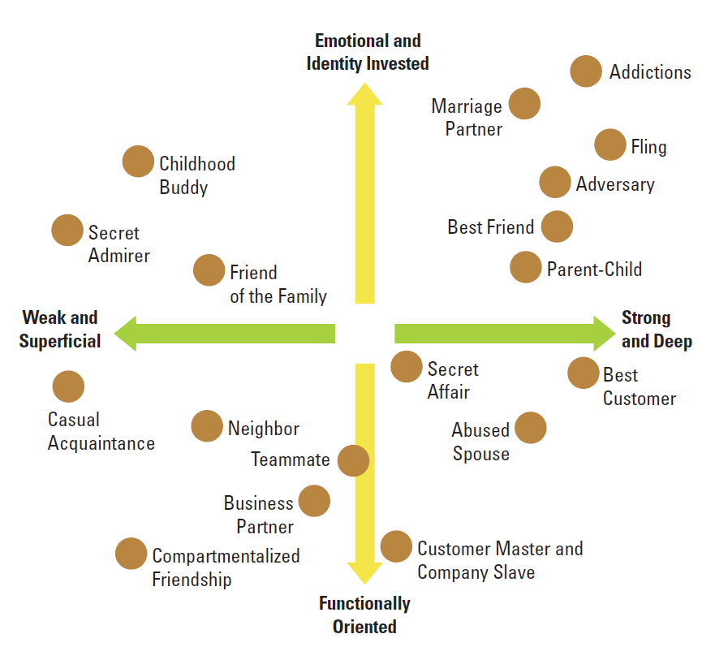

Slide 20
Two-Way Relationships
How do you improve a strained relationship?
Are firms enablers of bad behavior?

Slide 21
How-to Manage Relationships
Analyze the Portfolio of Relationships
Develop a Relationship Strategy
Design Appropriate Differentiated Strategies
Track Relationship Performance

Slide 22
Team Case
Hilton Hotels Case
Assignment Expectations:
  About 3-5 pages total
  Make sure you provide sufficient evidence for your claims and logical reasoning for any strategic advice you give

Slide 23
For Next Class
Topic:
  Balancing Customer Acquisition, Retention, and Add-on Selling
Reading:
  Getting the Most Out of All Your Customers (download)
Assignment:
  Team Case: Hilton Hotels: Brand Differentiation through Customer Relationship Management

